Slide 1
Chapter 13:
Object-Oriented Data Modeling
Modern Database Management
10th Edition
Jeffrey A. Hoffer, V. Ramesh,
Heikki Topi
© 2011 Pearson Education, Inc. Publishing as Prentice Hall

Slide 2
Objectives
Define terms
Describe phases of object-oriented development life cycle
State advantages of object-oriented modeling
Compare object-oriented model with E-R and EER models
Model real-world application using UML class diagram
Provide UML snapshot of a system state
Recognize when to use generalization, aggregation, and composition
Specify types of business rules in a class diagram

Slide 3
What Is Object-Oriented Data Modeling?
Centers around objects and classes
Involves inheritance
Encapsulates both data and behavior
Benefits of Object-Oriented Modeling
  Ability to tackle challenging problems
  Improved communication between users, analysts, designers, and programmers
  Increased consistency in analysis, design, and programming
  Explicit representation of commonality among system components
  System robustness
  Reusability of analysis, design, and programming results
Notes:
Centers around objects and classes! An object is that thing you trying to represent. Could be a noun or a verb, a person or an order
Involves inheritance – much like EER (subtype and supertype)
Encapsulates both data and behavior
Benefits of Object-Oriented Modeling
Ability to tackle challenging problems
Improved communication between users, analysts, designers, and programmers
Increased consistency in analysis, design, and programming
Explicit representation of commonality among system components
System robustness
Reusability of analysis, design, and programming results

Slide 4
OO vs. EER Data Modeling
Object Oriented
EER
Class
Entity type
Object
Entity instance
Association
Relationship
Inheritance of attributes
Inheritance of attributes
Inheritance of behavior
No representation of behavior
Object-oriented modeling is typically represented using the Unified Modeling Language (UML)

Slide 5
Classes and Objects
Class: An entity that has a well-defined role in the application domain, as well as state, behavior, and identity
  Tangible: person, place or thing
  Concept or Event: department, performance, marriage, registration
  Artifact of the Design Process: user interface, controller, scheduler
Object: a particular instance of a class
Objects exhibit BEHAVIOR as well as attributes
➔ Different from entities

Slide 6
State, Behavior, Identity
State: attribute types and values
Behavior: how an object acts and reacts
  Behavior is expressed through operations that can be performed on it
Identity: every object has a unique identity, even if all of its attribute values are the same
Notes:
State: attribute types and values -> data types and values
Behavior: how an object acts and reacts
Behavior is expressed through operations that can be performed on it
Identity: every object has a unique identity, even if all of its attribute values are the same – a primary key

Slide 7
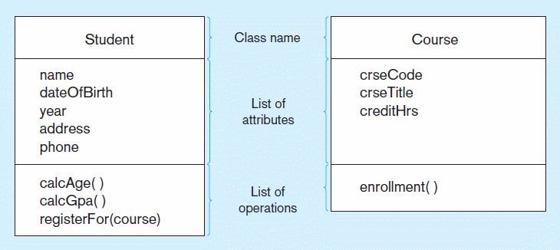
Figure 13-2 UML class and object diagram
a) Class diagram showing two classes
Class diagram shows the static structure of an object-oriented model: object classes, internal structure, relationships
Notes:
Class attributes
Operations or behaviors
Relationship through behaviors

Slide 8
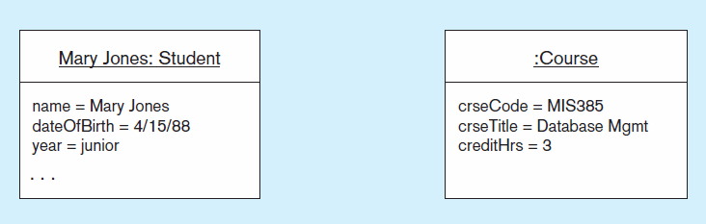
Figure 13-2 UML class and object diagram (cont.)
b) Object diagram with two instances
Object diagram shows instances that are compatible with a given class diagram
Notes:
Object, a particular instance of the class

Slide 9
Operation
A function or service that is provided by all instances of a class
Encapsulation – hiding internal implementation details
Types of operations:
  Constructor: creates a new instance of a class
  Query: accesses the state of an object but does not alter its state
  Update: alters the state of an object
  Class-Scope: operation applying to the class instead of an instance
Operations implement the object’s behavior
Notes:
A function or service that is provided by all instances of a class – what can you do with a calss. calcGPA etc
Encapsulation – hiding internal implementation details – only the signature is expose
Types of operations:
Constructor: creates a new instance of a class!
Query: accesses the state of an object but does not alter its state
Update: alters the state of an object
Class-Scope: operation applying to the class instead of an instance

Slide 10
Associations
Association
  Named relationship among object classes
Association Role
  Role of an object in an association
  The end of an association where it connects to a class
Multiplicity
  How many objects participate in an association. Lower-bound...Upper-bound (cardinality)
Notes:
Association
Named relationship among object classes--- registration for example
Association Role
Role of an object in an association -
The end of an association where it connects to a class… e.g. Relationship between a flight and a city, you may write destination
Multiplicity
How many objects participate in an association. Lower-bound...Upper-bound (cardinality)
one to many, one to one, many to many etc

Slide 11
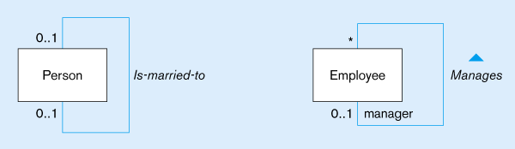
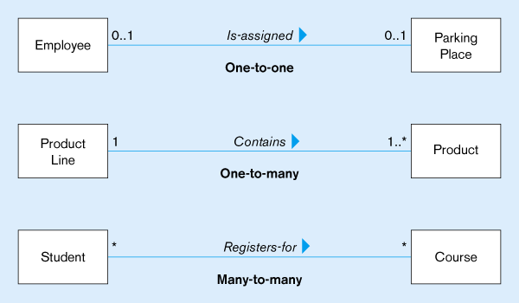
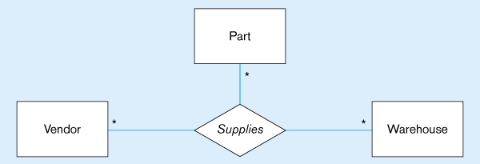
Figure 13-3
Examples of association relationships of different degrees
Unary
Lower-bound – upper-bound
Represented as:
0..1, 0..*, 1..1, 1..*
Similar to minimum/maximum cardinality rules in EER
Binary
Ternary
Notes:
Lower bound, and upper bound

Slide 12
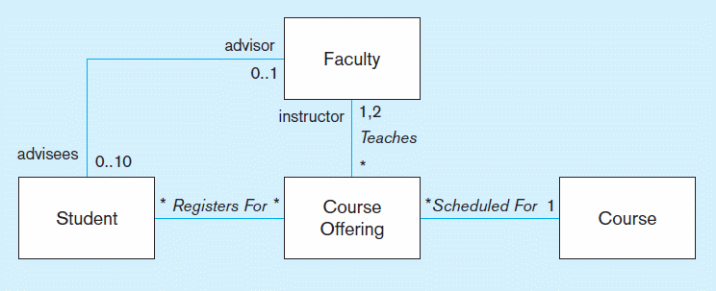
Figure 13-4 Examples of binary association relationships
a) University example
Alternative multiplicity representation: specifying the two possible values in a list instead of a range

Slide 13
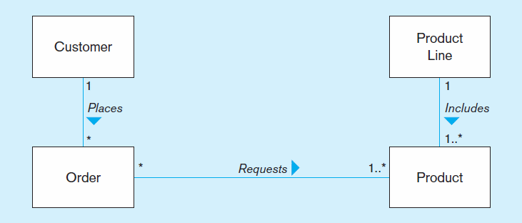
Figure 13-4 Examples of binary association relationships (cont.)
b) Customer order example

Slide 14
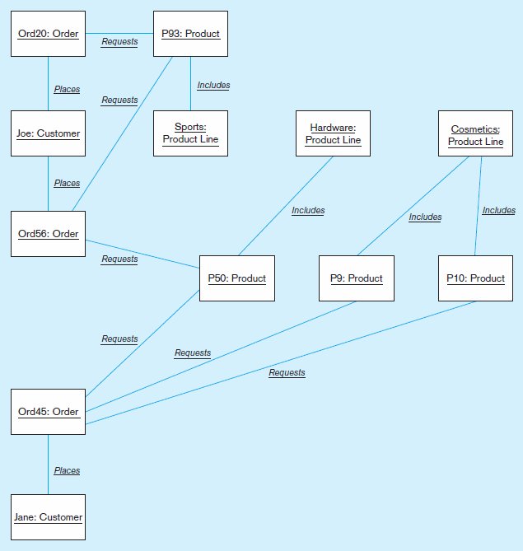
Figure 13-5
Object diagram for customer order example
Object diagram shows associations between specific object instances

Slide 15
Association Class
An association that has attributes or operations of its own or that participates in relationships with other classes
Like an associative entity in E-R model

Slide 16
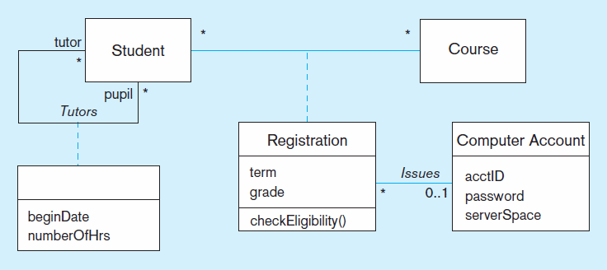
Figure 13-6 Association class and link object
a) Class diagram showing association classes
Binary association class with behavior
Unary association with only attributes and no behavior

Slide 17
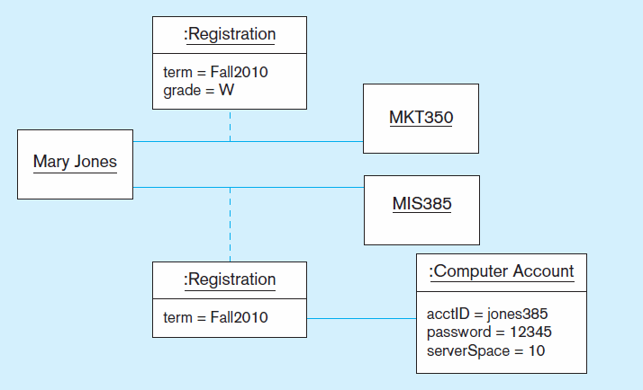
Figure 13-6 Association class and link object (cont.)
b) Object diagram showing link objects
Association class
instances

Slide 18
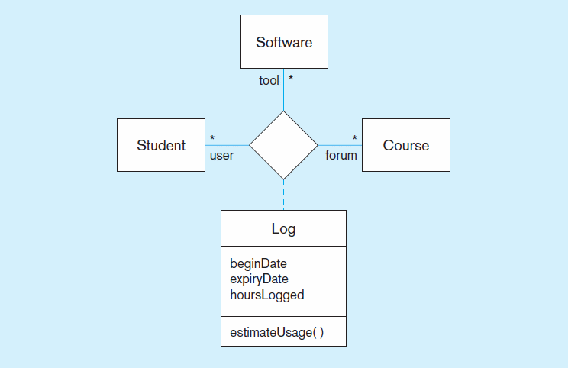
Figure 13-7 Ternary relationship with association class

Slide 19
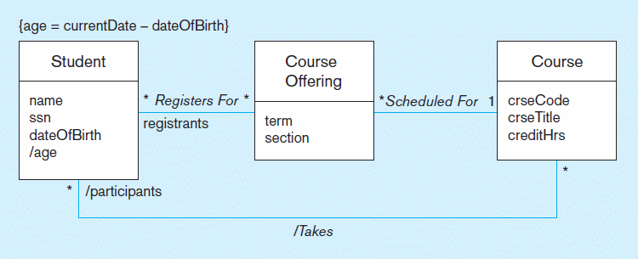
Figure 13-8 Derived attribute, association, and role
Constraint expression for derived attribute
Derived attribute
Derived relationship (from Registers-for and Scheduled-for)
Derived attributes and relationships shown with / in front of the name

Slide 20
Generalization/Specialization
Subclass, superclass
  similar to subtype/supertype in EER
Common attributes, relationships, and operations
Disjoint vs. Overlapping
Complete (total specialization) vs. incomplete (partial specialization)
Abstract Class: no direct instances possible, but subclasses may have direct instances
Concrete Class: direct instances possible
Notes:
Subclass, superclass
similar to subtype/supertype in EER
Common attributes, relationships, and operations
Disjoint vs. Overlapping – can a super class be more than one subclass?
Complete (total specialization) vs. incomplete (partial specialization)
Abstract Class: no direct instances possible, but subclasses may have direct instances /* only exist through subclass*/
Concrete Class: direct instances possible /* direct instance is possible*/

Slide 21
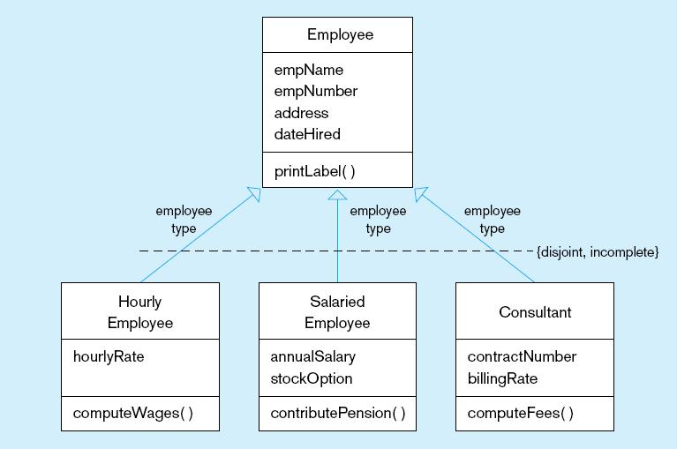
Figure 13-9 Examples of generalization, inheritance, and constraints
a) Employee superclass with three subclasses
An employee can only be one of these subclasses
Shared attributes and operations
An employee may be none of them
Specialized attributes and operations

Slide 22
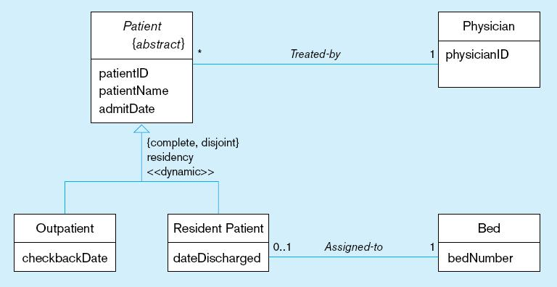
Figure 13-9 Examples of generalization, inheritance, and constraints (cont.)
b) Abstract Patient class with two concrete subclasses
Abstract indicated by italics
A patient MUST be EXACTLY one of the subtypes
Dynamic means a
patient can change from one subclass to another over time

Slide 23
Class-Scope Attribute
Specifies a value common to an entire class, rather than a specific value for an instance
Represented by underlining
“=“ is initial, default value

Slide 24
Polymorphism
Abstract Operation: Defines the form or protocol of the operation, but not its implementation
Method: The implementation of an operation
Polymorphism: The same operation may apply to two or more different classes in different ways

Slide 25
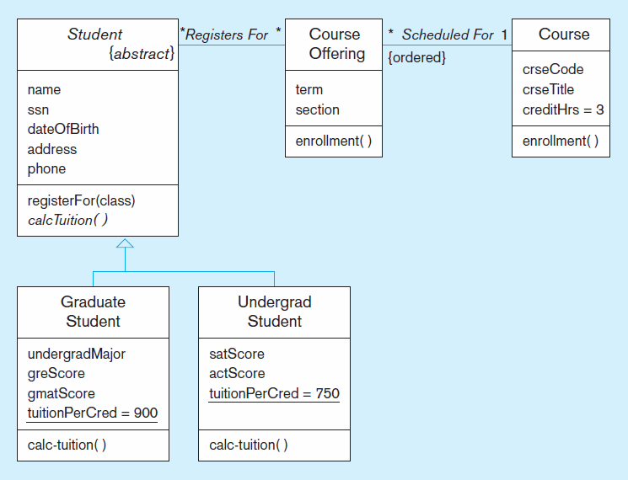
Figure 13-11 Polymorphism, abstract operation, class-scope attribute, and ordering
This operation is abstract…it has no method at Student level
Class-scope attributes–only one value common to all instances of these classes (includes default values)
Methods are defined at subclass level

Slide 26
Overriding Inheritance
Overriding: The process of replacing a method inherited from a superclass by a more specific implementation of that method in a subclass
  For Extension: add code
  For Restriction: limit the method
  For Optimization: improve code by exploiting restrictions imposed by the subclass

Slide 27
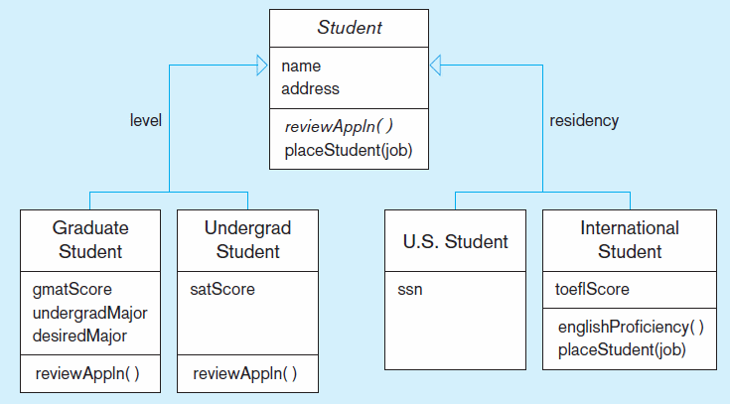
Figure 13-12 Overriding inheritance
Subclasses that do not override placeStudent use the default behavior
Restrict job placement

Slide 28
Multiple Inheritance
Multiple Classification: An object is an instance of more than one class
Multiple Inheritance: A class inherits features from more than one superclass

Slide 29
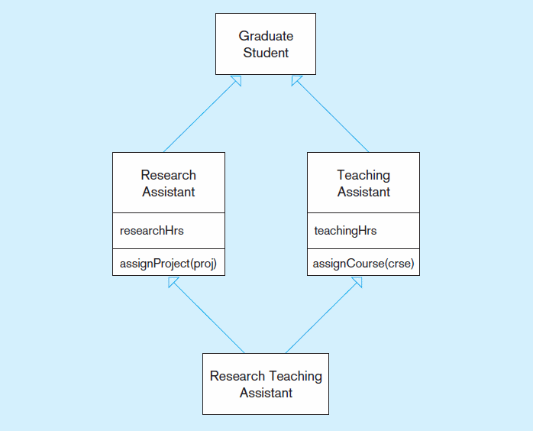
Figure 13-13 Multiple inheritance

Slide 30
Aggregation
Aggregation: A part-of relationship between a component object and an aggregate object
Composition: A stronger form of aggregation in which a part object belongs to only one whole object and exists only as part of the whole object
Recursive Aggregation: Composition where component object is an instance of the same class as the aggregate object

Slide 31
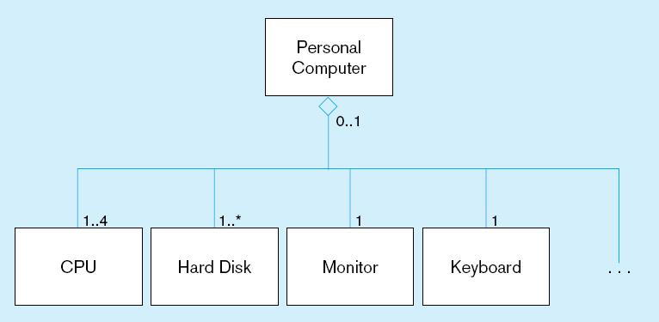
Figure 13-14 Example of aggregation
A Personal Computer includes CPU, Hard Disk, Monitor, and Keyboard as parts. But, these parts can exist without being installed into a computer. The open diamond indicates aggregation, but not composition.

Slide 32
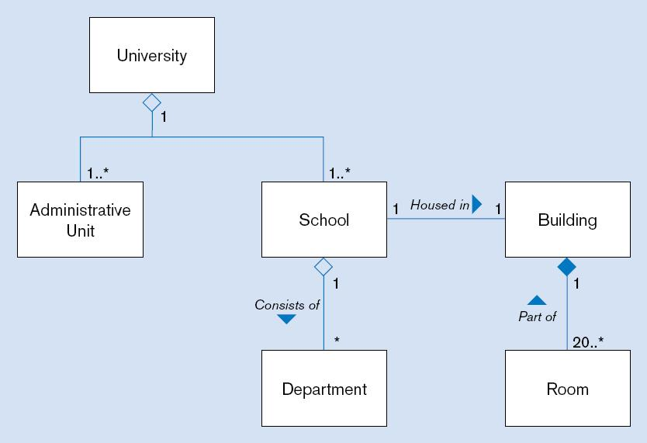
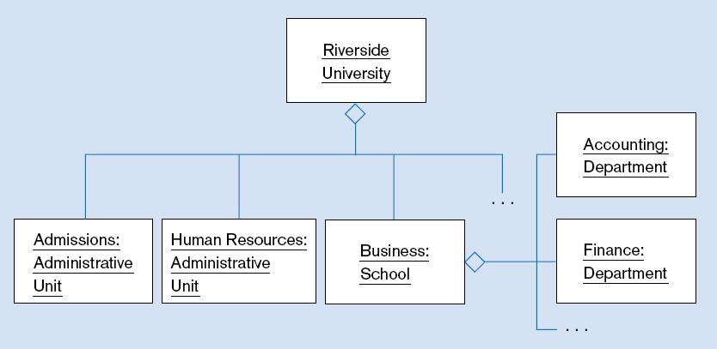
Figure 13-15 Aggregation and Composition
(a) Class diagram
Closed diamond indicates composition. The room cannot exist without the building.
(b) Object diagram

Slide 33
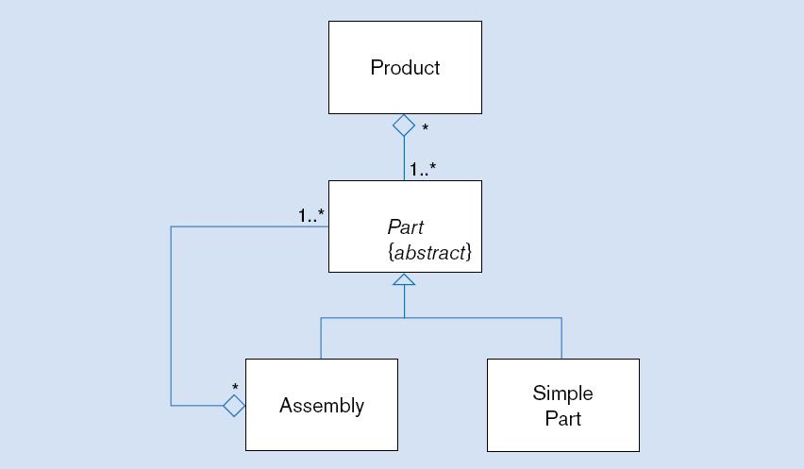
Figure 13-16 Recursive aggregation

Slide 34
Business Rules
See Chapters 2 and 3
Implicit and explicit constraints on objects – for example:
  cardinality constraints on association roles
  ordering constraints on association roles
Business rules involving two graphical symbols:
  labeled dashed arrow from one to the other
Business rules involving three or more graphical symbols:
  note with dashed lines to each symbol

Slide 35
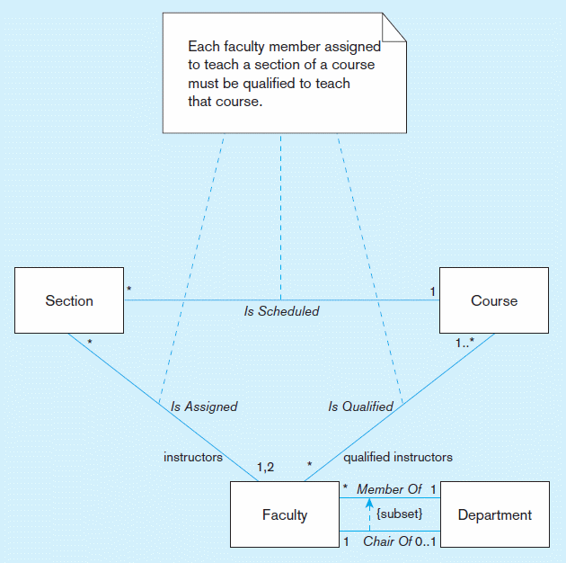
Figure 13-17 Representing business rules
Three-symbol constraint
Two-symbol constraint

Slide 36
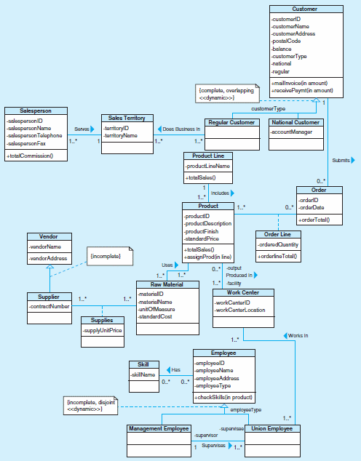
Figure 13-18 Class diagram for Pine Valley Furniture Company

